Slide 1
Part II-Software Testing
Abstraction Level of Testing

Slide 2
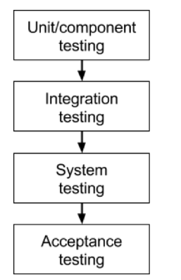
Today’s Outline
Abstraction Level of Testing
Unit testing
Integration testing
System testing
Acceptance testing

Slide 3
Unit testing
The most basic type of testing
Unit testing aims to verify each part of the software by isolating it and then perform tests to demonstrate that each individual component is correct in terms of fulfilling requirements and the desired functionality.
White box testing
This type of testing is performed at the earliest stages of the development process, and in many cases it is executed by the developers themselves before handing the software over to the testing team.
The advantage of detecting any errors in the software early in the day is that by doing so the team minimizes software development risks, as well as time and money wasted in having to go back and undo fundamental problems in the program once it is nearly completed.

Slide 4
Integration testing
Integration testing aims to test different parts of the system in combination in order to assess if they work correctly together.
By testing the units in groups, any faults in the way they interact together can be identified.
There are many ways to test how different components of the system function at their interface; testers can adopt either a bottom-up or a top-down integration method.
In bottom-up integration testing, testing builds on the results of unit testing by testing higher-level combination of units (called modules) in successively more complex scenarios.
It is recommended that testers start with this approach first, before applying the top-down approach which tests higher-level modules first and studies simpler ones later.

Slide 5
Stubs and Drivers
When testing incomplete portions of software, developers and testers often need extra software components, sometimes called scaffolding.
The two most common types of scaffolding are known as test stubs and test drivers.
A test stub is a skeletal or special-purpose implementation of a software module, used to develop or test a component that calls the stub or otherwise depends on it. It replaces a called component.
The simplest action for a stub is to assign constant values to the outputs.

Slide 6
Stubs and Drivers
A test driver is a software component or test tool that replaces a component that takes care of the control and/or the calling of a software component.
The simplest form of driver is a main() method for a class.
Effective programmers often include a main() for every class, containing statements that carry out simple testing of the class.
Test drivers can include hard-coded values or retrieve the values from an external source like the tester or a ﬁle. Tools exist to generate test drivers automatically.

Slide 7
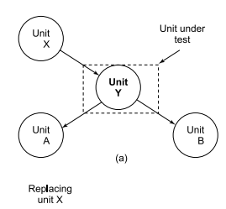
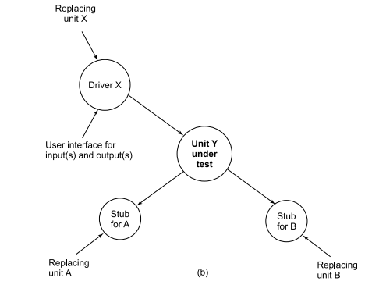
Stubs and Drivers

Slide 8
Top-down Testing
T1
T1
A
A
T2
T2
B
B
T3
T3
C
T4

Slide 9
system testing
As the name implies, all the components of the software are tested as a whole in order to ensure that the overall product meets the requirements specified.
System testing is a very important step as the software is almost ready to ship and it can be tested in an environment which is very close to that which the user will experience once it is deployed.
Black box testing

Slide 10
acceptance testing
Finally, acceptance testing is the level in the software testing process where a product is given the green light or not. The aim of this type of testing is to evaluate whether the system complies with the end-user requirements and if it is ready for deployment.
The testing team will utilize a variety of methods, such as pre-written scenarios and test cases to test the software and use the results obtained from these tools to find ways in which the system can be improved.
By performing acceptance tests, the testing team can find out how the product will perform when it is installed on the user’s system. There are also various legal and contractual reasons why acceptance testing has to be carried out.
Notes:
The scope of acceptance testing ranges from simply finding spelling mistakes and cosmetic errors, to uncovering bugs that could cause a major error in the application.

Slide 11
Who Performs the Tests?
Unit Testing
Integration Testing
System Testing

Slide 12
Where to Perform the Tests?
Typically at the software developer’s site..
For system tests, test at developer’s or customer’s site (target site).
If outsourced, testing can be done at consultant’s site.

Slide 13
Test Plans
The goal of test planning is to establish the list of tasks which, if performed, will identify all of the requirements that have not been met in the software. The main work product is the test plan.
The test plan documents the overall approach to the test. The test plan serves as a summary of the test activities that will be performed.
It shows how the tests will be organized, and outlines all of the testers’ needs which must be met in order to properly carry out the test.
The test plan should be inspected by members of the engineering team and senior managers.

Slide 14
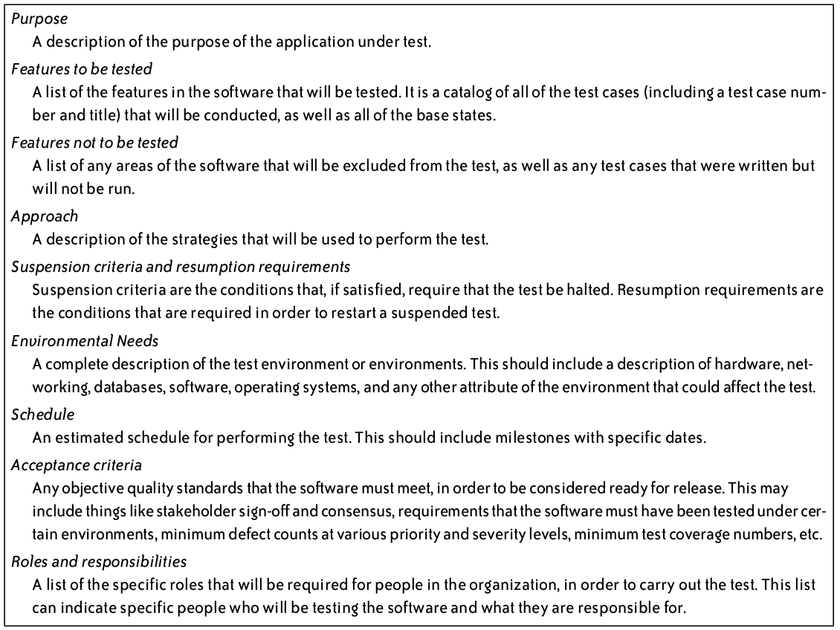
Test Plan Outline

Slide 15
Test Cases
A test case is a description of a specific interaction that a tester will have in order to test a single behavior of the software. Test cases are very similar to use cases, in that they are step-by-step narratives which define a specific interaction between the user and the software.
A typical test case is laid out in a table, and includes:
A unique name and number
A requirement which this test case is exercising
Preconditions which describe the state of the software before the test case (which is often a previous test case that must always be run before the current test case)
Steps that describe the specific steps which make up the interaction
Expected Results which describe the expected state of the software after the test case is executed
Test cases must be repeatable.
Good test cases are data-specific, and describe each interaction necessary to repeat the test exactly.

Slide 16
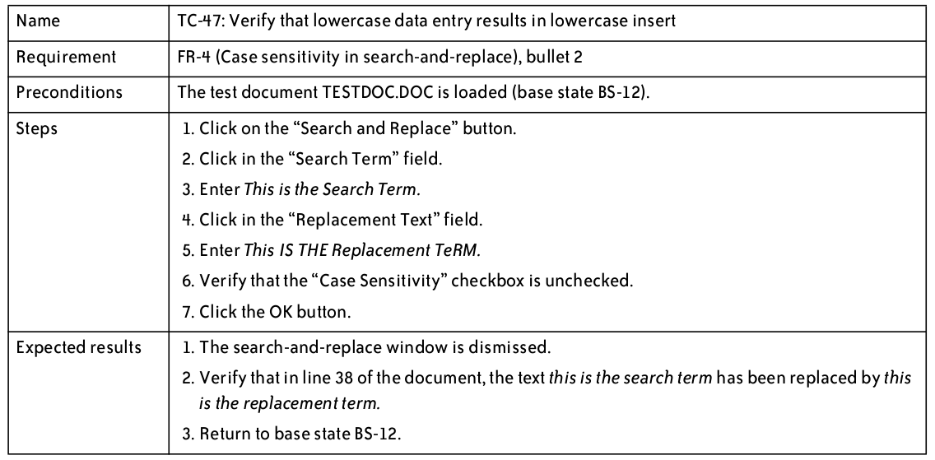
Test Cases – Good Example

Slide 17
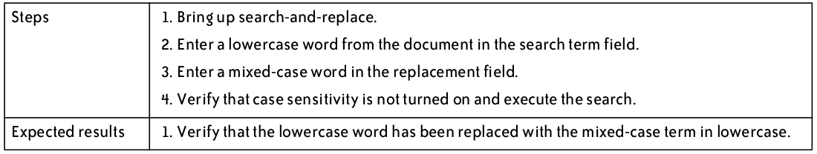
Test Cases – Bad Example

Slide 18
Test Execution
The software testers begin executing the test plan after the programmers deliver the alpha build, or a build that they feel is feature complete.
The alpha should be of high quality—the programmers should feel that it is ready for release, and as good as they can get it.
There are typically several iterations of test execution.
The first iteration focuses on new functionality that has been added since the last round of testing.
A regression test is a test designed to make sure that a change to one area of the software has not caused any other part of the software which had previously passed its tests to stop working.
Regression testing usually involves executing all test cases which have previously been executed.

Slide 19
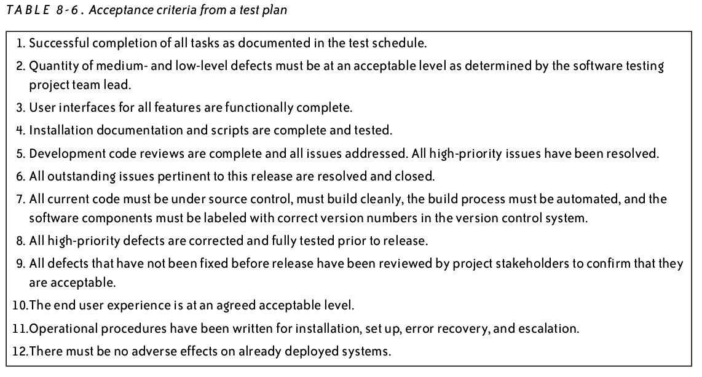
Test Execution
When is testing complete?
No defects found
Or defects meet acceptance criteria outlined in test plan

Slide 20
Test suite
A set of test scripts or test procedures to be executed in a specific test run.
When you have hundreds / thousands of test cases, a test suite allows you to categorize them in a way that matches your planning or analysis needs.
For example, you could have a test suite for each of the core features of the software or you could have a separate test suite for a particular type of testing.
An example of a test suite for purchasing a product could comprise of the following test cases:
Test Case 1: Login
Test Case 2: Add Products
Test Case 3: Checkout
Test Case 4: Logout
Each of the test cases above are dependent on the success of the previous test cases.

Slide 21
Test log report
The test case log documents different test cases for a particular test type to be executed during testing.
It also records the results of the tests, which provides the detailed evidence for the test log summary report and enables us to reconstruct the test, if necessary.
Test Case ID
Requirement ID
Test Description
Test Data
Expected Result
Actual result
Pass/Fail

Slide 22
Regression testing
Regression testing is the process of re-testing software that has been modiﬁed.
Large components or systems tend to have large regression test suites. Small changes to one part of a system often cause problems in distant parts of the system.
Regression testing is used to ﬁnd this kind of problem.

Slide 23
Regression testing
It is worth emphasizing that regression tests must be automated.
Indeed, it could be said that unautomated regression testing is equivalent to no regression testing.
A wide variety of commercially available tools are available.

Slide 24
Software testing
Testing software applications is mandatory and inevitable because errors often become the part of software unintentionally during the design, code and implementation phase.
Software is becoming more complex nowadays, having many lines of code, and as a result more iterations of testing are needed to be performed.
Software testing is time taking and a costly process; hence, it is necessary to lessen human efforts in testing.

Slide 25
shortcomings of Manual testing
Time-consuming process
Involves more human efforts
Not as much of precise outcomes
Testing several features concurrently is not possible
Deficiency of reusability of testing trials
Deficiency of test comprehensiveness.

Slide 26
automated Software Testing
Benefits of Automation Testing
Drawbacks of Automation Testing
Factors to go for Automation Testing
Factors to Choose Automation Tool
Tools Available for Testing Software

Slide 27
automated software testing
The automated software testing is a method during which software testing tools run the already drafted test cases on a software program.
These testing tools manage the carrying out of test cases and then do the evaluation of actual results by comparing it with the expected results. It can automate
Software Business Application Critical test cases,
test cases that need to be run again and again
test Cases that are very laborious to perform manually or
test Cases that take a lot of time for execution
in a systematize testing process.
The foremost objective of automated testing is to ease the efforts involved in the testing process as much as possible by writing a minimal set of testing scripts.
Notes:
Let’s say that unit testing involves a great amount of resources that the quality assurance team has, then this unit testing process can be a fair nominee for the automation process

Slide 28
Common Automation Tools
There are many test automation tools available in the market.
Each automation tool has some strong points and some shortcomings and serves an alternate need.
A thorough investigation of those different automation tools ought to be performed prior to choosing any tool.
Many factors are thought of for the evaluation of these tools such as cost, software type, testing prerequisites, abilities needed to utilize the tool etc.

Slide 29
Automation Tools Comparison
 | Price | Platform | Supported Language | Tested app | Coding Skills required | Learning curve
Selenium | Free | Windows/Mac/Linux | Java, Python, C#, PHP, Javascript, Ruby, Perl | Web, mobiles | Advanced skills | Steep
Test complete | License and maintenance fees | Windows | VB, Jscript, Python, C++, C#, PHP, Javascript, Ruby, | Web, mobiles, desktop | Minimum skills, Advanced skills for pro scripting | Mild
Katalon Studio | Free | Windows, Mac | Java, Groovy | Web, mobile | Minimum skills, Advanced skills for pro scripting | Mild
UFT | License and maintenance fees | Windows | VB Script | Web, mobiles, desktop | Minimum skills, Advanced skills for pro scripting | Moderate
Renorex | License and maintenance fees | Windows | C#, VB.Net, Python | Web, mobiles, desktop | Minimum skills, Advanced skills for pro scripting | Moderate

Slide 30
Selection of Automation Tool
Any automation tool can't be good or bad for all software projects.
Depending on the testing requirements, a combination of automation tools can also be used.

Slide 31
CHALLENGES IN TEST AUTOMATION
Automating the testing process is an important aspect of software testing.
By utilizing automated testing, we can facilitate and enhance the software validation process and increment testing inclusion. Nonetheless, there are a ton of difficulties in applying test automation for applications under test (AUT).
Without conquering these difficulties, testers may confront innumerable bad effects that can cause automated software testing failure.
The main four difficulties that highestly affect the general automation test exertion and task achievement are as per the following.
Viable Communicating and Collaborating in team
Selecting a Right Tool
Selecting a Proper Testing Approach
High Upfront Investment Cost

Slide 32

That is all

